Slide 1
Advancing Biometric Authentication: A Framework for Template Reconstruction Attack Detection
Presented by
K. Babinadh - AP22110010314
Y. Teja - AP22110010409
D. Satya Koushik - AP22110010454
M. Nithin Sai - AP22110010406
UNDER SUPERVISION
Dr. Dilip Kumar Vallabhadas

Slide 2
Agenda
01 Introduction
02 The problem
03 Research objectives
04 Methods & Limitations
05 Dataset
06 System architecture
07 Result

Slide 3
Introduction
Biometric authentication (especially fingerprints) is widely used for secure access.
Unlike passwords, biometric data cannot be changed if compromised.
Stolen fingerprint templates can be used to create synthetic identities (reconstruction attacks).
This work focuses on detecting such attacks to enhance biometric security.

Slide 4
The Problem: Biometric Templates Are Not Secret
What Is a Biometric Template?
A mathematical representation of a fingerprint stored in a database — the core credential for authentication.
The Core Threat
If a template is leaked, attackers can reconstruct a synthetic fingerprint that passes verification. Unlike passwords, biometrics cannot be reset.

Slide 5
Why This Problem Is Urgent Now
Irrevocable Credentials
Biometrics are permanent — a compromised template is a lifetime vulnerability.
AI-Powered Attacks
GANs and diffusion models can synthesize high-fidelity fingerprints from leaked templates.
Scaling Threat Surface
Mass biometric deployments in banking, mobile, and government multiply attack incentives.

Slide 6
Research Objectives
Detect Reconstruction Attacks
Identify adversarial attempts to reconstruct or exploit stored biometric templates in real time.
Strengthen Template Security
Apply Dynamic Random Projection to ensure non-invertibility and revocability of stored templates.
Preserve Authentication Accuracy
Maintain low EER and high recognition rates while adding active defense layers.
Enable Real-World Deployment
Design a lightweight framework compatible with mobile and enterprise authentication systems.

Slide 7
Existing Methods & Their Limitations
The Critical Gap
Current approaches are passive — they protect at rest but cannot detect active reconstruction attempts during authentication.
No mechanism to flag adversarial template queries
Cancelable biometrics lack revocation granularity
Spoof detection ignores template-space attacks

Slide 8
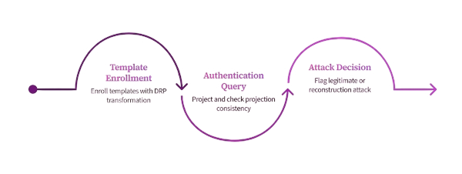
Proposed Solution: Hybrid Dynamic Projection Framework
A novel Hybrid Dynamic Projection-based Detection Framework that identifies inconsistencies in reconstructed templates during authentication.
The framework intercepts each authentication attempt, applies dynamic random projection, and analyzes score distributions to distinguish genuine users from reconstructed adversarial inputs.

Slide 9
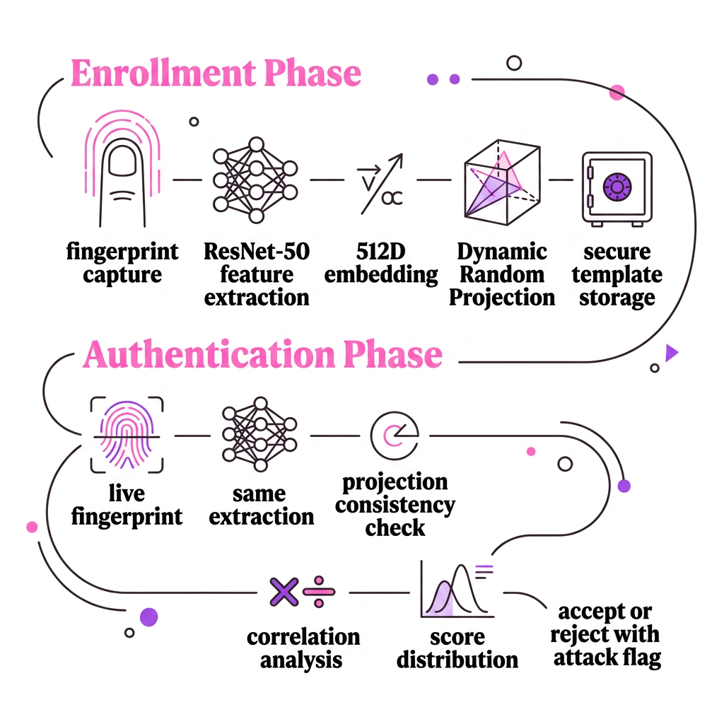
System Architecture
Enrollment Phase
Fingerprint → ResNet-50 → 512D embedding → DRP → Secure storage
Authentication Phase
Live scan → Same extraction → Projection consistency check → Correlation analysis → Accept or flag attack

Slide 10
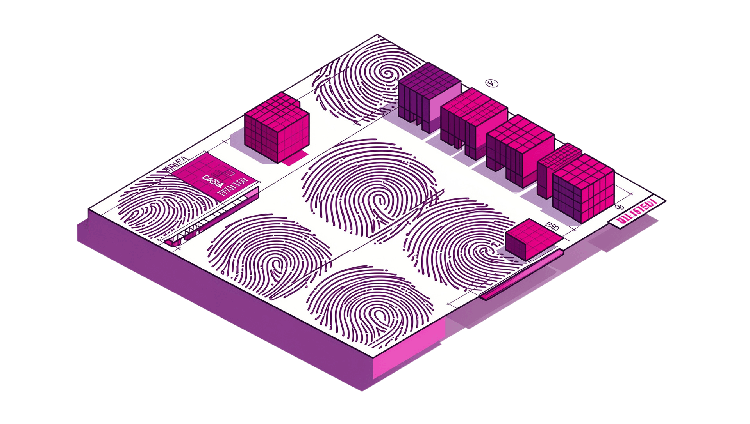
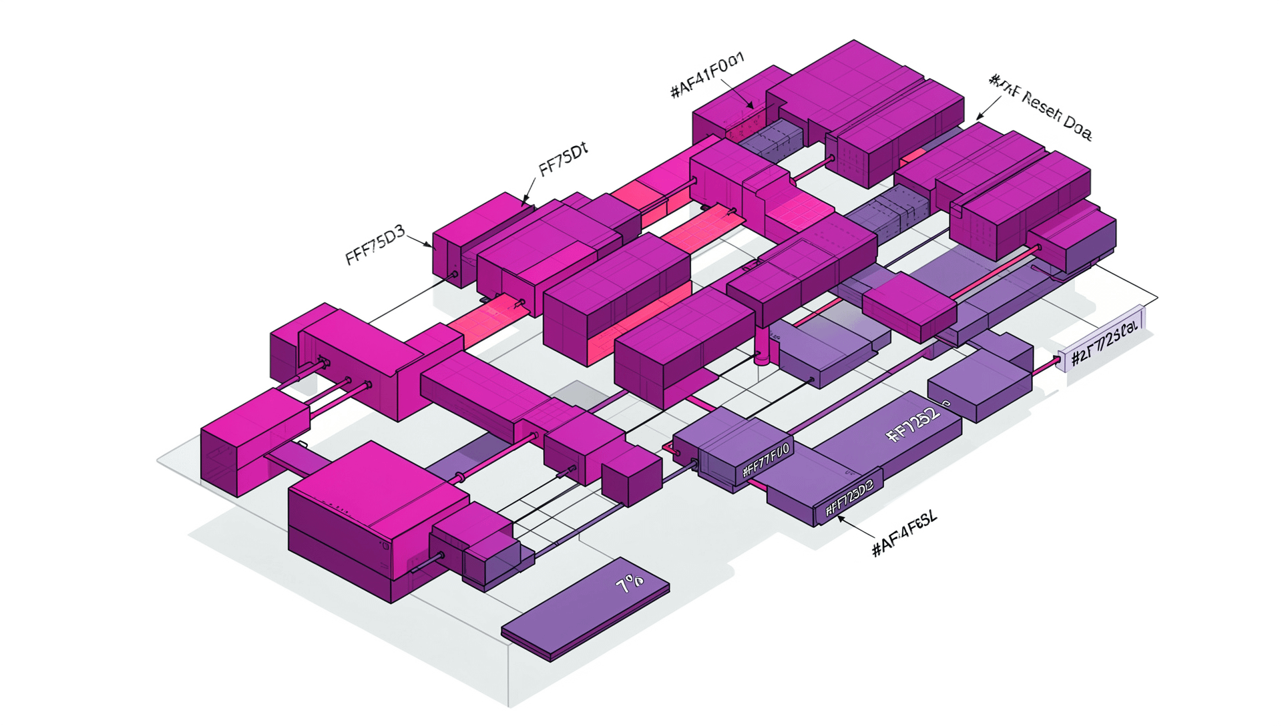
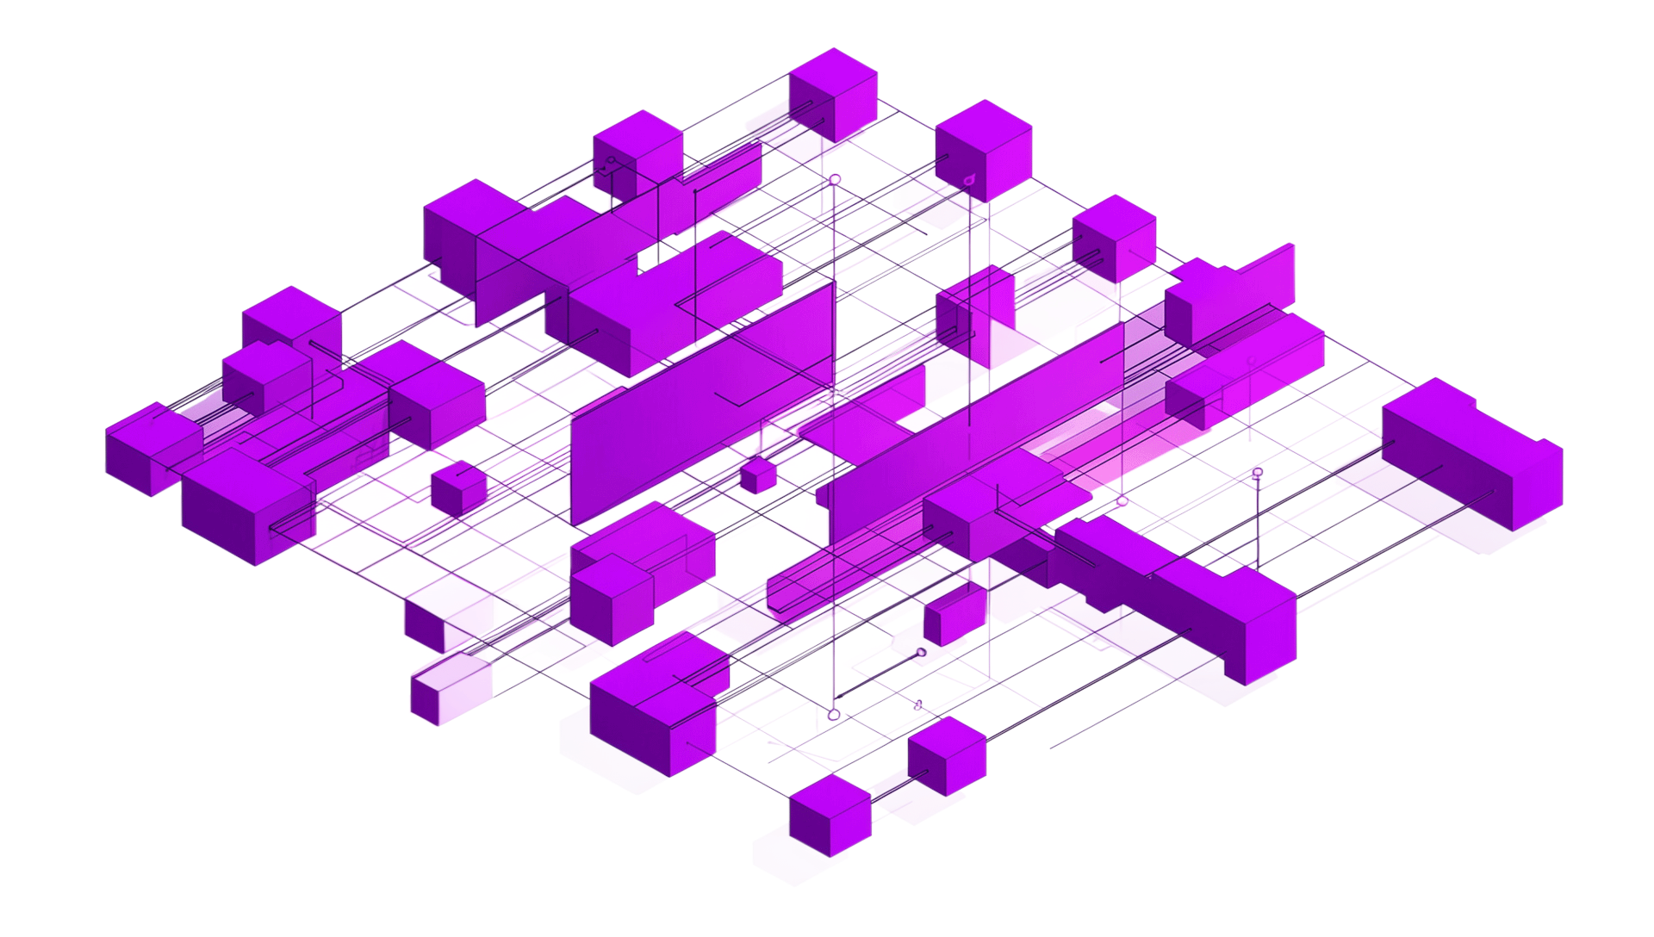
Dataset, Feature Extraction & Template Protection
CASIA Fingerprint Dataset
Augmented with noise, blur, and compression to simulate real-world attack conditions and adversarial reconstruction scenarios.
ResNet-50 Feature Extraction
Transfer learning produces 512-dimensional embeddings capturing fine-grained minutiae patterns robust to variation.
Dynamic Random Projection
Session-specific projection matrices ensure non-invertibility, revocability, and diversity across deployments.

Slide 11
Attack Detection & Training Strategy
Detection Signals
Projection Consistency
Reconstructed templates fail to align under dynamic projection transforms.
Training Configuration
Loss: Cross-entropy with class weighting
Optimizer: Adam with adaptive learning rate
Regularization: Early stopping + LR scheduling
Validation: Stratified k-fold cross-validation
Correlation Differences
Adversarial inputs exhibit statistically distinct correlation profiles vs. genuine samples.
Score Distribution Analysis
Anomaly detection on match score distributions flags outliers.
Training includes both genuine and synthetically reconstructed templates for adversarial robustness.

Slide 12
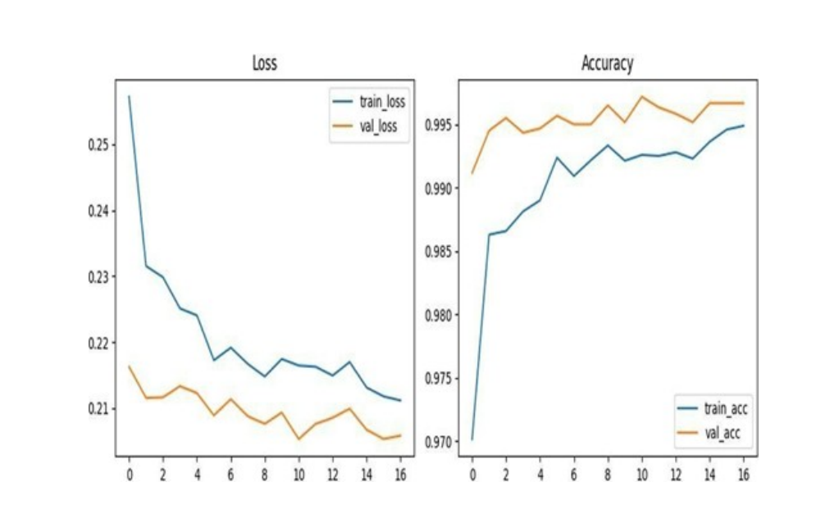
Results & Comparative Performance
Key Metrics Achieved
Outperforms cancelable biometrics and spoof detection baselines across all metrics, with significant EER reduction.
~99% Accuracy
Best-in-class detection rate
Low EER
Minimal false accepts & rejects
High AUC-ROC
Strong discriminative power

Slide 13
Thank you
K. Babinadh - AP22110010314
Y. Teja - AP22110010409
D. Satya Koushik - AP22110010454
M. Nithin Sai - AP22110010406

